Slide 1
Эффект отдачи нейтронных звезд в магниторотационных сверхновых
Илья Кондратьев, С.Г. Моисеенко, Г.С. Бисноватый-Коган
ИКИ РАН
Семинар отдела релятивистской астрофизики ГАИШ МГУ
25 февраля 2025 года

Slide 2
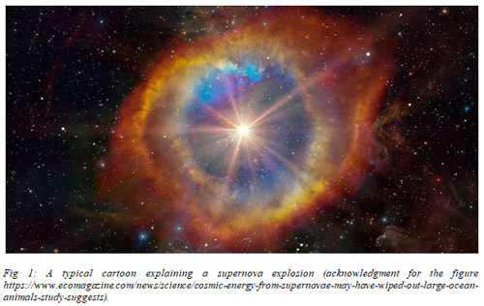
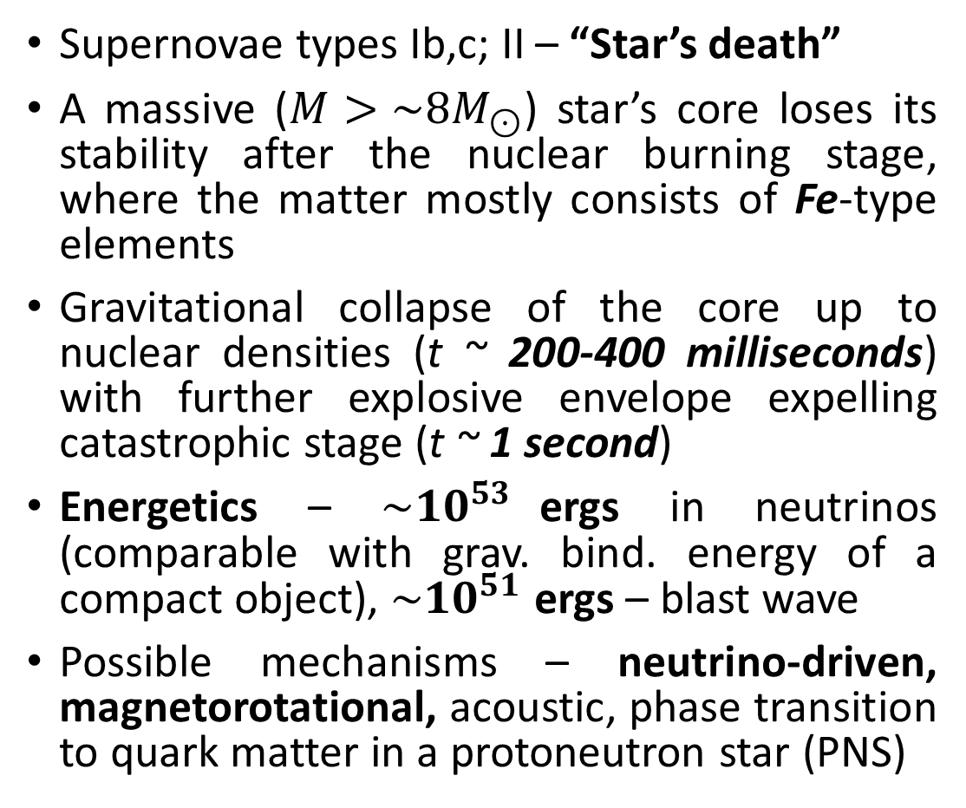
Core-collapse supernovae
Supernovae types Ib,c; II – “Star’s death”
A massive ($M>\sim 8M_{⊙}$) star’s core loses its stability after the nuclear burning stage, where the matter mostly consists of Fe-type elements
Gravitational collapse of the core up to nuclear densities (t ~ 200-400 milliseconds) with further explosive envelope expelling catastrophic stage (t ~ 1 second)
Energetics – ${\sim 10}^{53}$ergs in neutrinos (comparable with grav. bind. energy of a compact object), ${\sim 10}^{51}$ ergs – blast wave
Possible mechanisms – neutrino-driven, magnetorotational, acoustic, phase transition to quark matter in a protoneutron star (PNS)
H.-Th. Janka, Ann Rev Nucl Part Sci (2012)

Slide 3
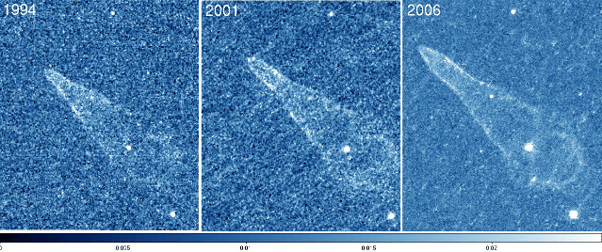
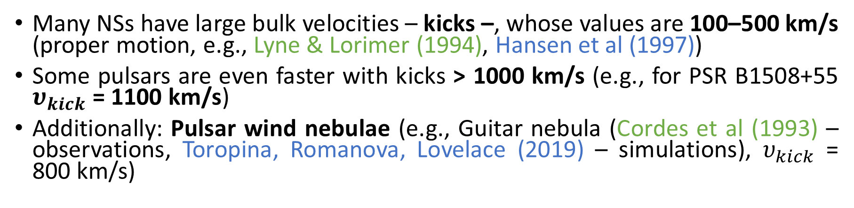
Linear velocities of NSs and SNe explosions
Many NSs have large bulk velocities – kicks –, whose values are 100–500 km/s (proper motion, e.g., Lyne & Lorimer (1994), Hansen et al (1997))
Some pulsars are even faster with kicks > 1000 km/s (e.g., for PSR B1508+55 $υ_{kick}$= 1100 km/s)
Additionally: Pulsar wind nebulae (e.g., Guitar nebula (Cordes et al (1993) – observations, Toropina, Romanova, Lovelace (2019) – simulations), $υ_{kick}$ = 800 km/s)
Standard hypothesis* – presence of angular asymmetry in a blast wave form and/or neutrino flash during SN explosion => uncompensated momentum is transferred to PNS
Blast wave asymmetry: Bisnovatyi-Kogan & Moiseenko (1992) – MR (estimate), Powell et al (2023) – MR (simulations for two 3D models), Scheck et al (2006), Wongwathanarat et al (2010, 2013), Coleman, Burrows et al (2024) – nu+SASI (simulations)
*”natal kick”, additionally, a EM rocket effect could operate on a whole pulsar lifetime (Harrison & Tademaru (1975))
Guitar PWN, Credits : HST

Slide 4
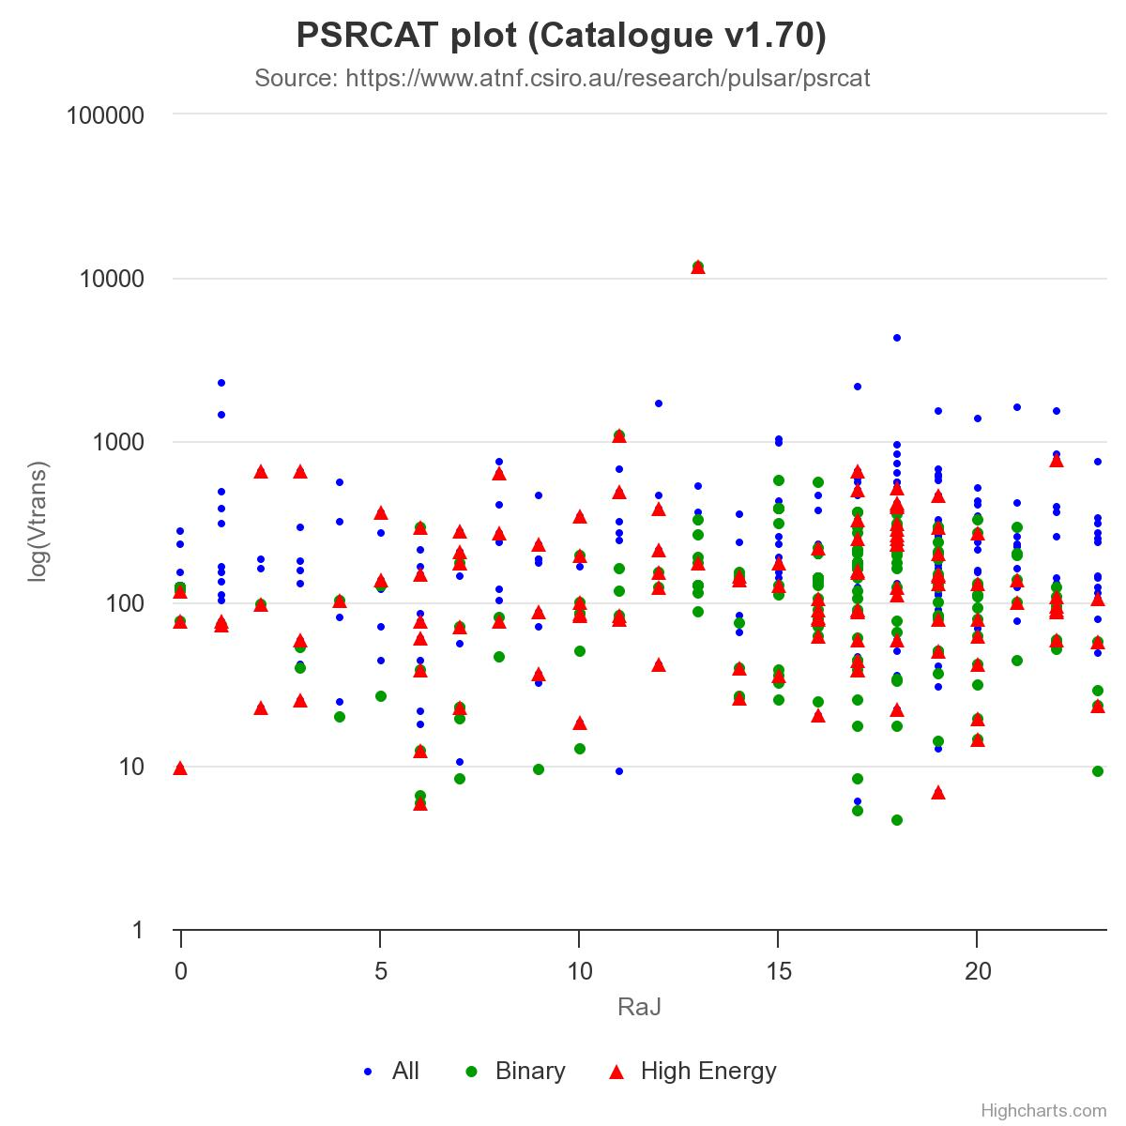
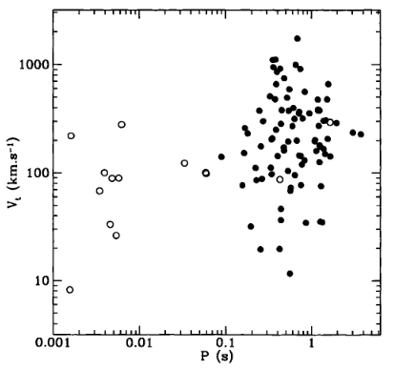
Neutron star kicks distribution
Ref.: B. M. S. Hansen and E. S. Phinney, Mon. Not. R. Astron. Soc. 291, 569-577 (1997)
Ref.: Manchester, R. N., Hobbs, G.B., Teoh, A. & Hobbs, M., AJ, 129, 1993-2006 (2005)

Slide 5
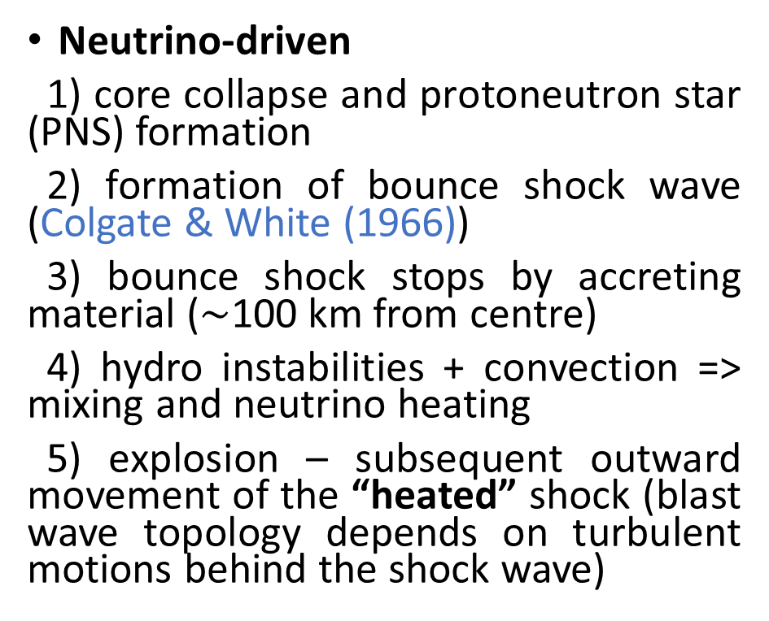


Core collapse supernovae: the mechanisms
refs.: Bethe & Wilson (1985) – nu-convection, Blondin et al (2003), Foglizzo et al (2006) – SASI, and many-many more!
refs.: Bisnovatyi-Kogan (1970) – CCSNe,
LeBlanc & Wilson (1970) – rotational energy extraction
Neutrino-driven
1) core collapse and protoneutron star (PNS) formation
2) formation of bounce shock wave (Colgate & White (1966))
3) bounce shock stops by accreting material ($\sim$100 km from centre)
4) hydro instabilities + convection => mixing and neutrino heating
5) explosion – subsequent outward movement of the “heated” shock (blast wave topology depends on turbulent motions behind the shock wave)
Magnetorotational (MR)
1) core collapse and formation of a differentially rotating PNS + envelope
2) rotational winding of toroidal magnetic field (Ω-effect in MHD)
3) magnetic pressure rise => compression wave => MHD shock
4) explosion – magnetized outflows (blast wave topology depends on initial configuration of rotation/B-field, outflows usually have jet-like structures)
Powerful SNe indeed can explode in jets! See observations of SN 2017gmr (Utrobin, Chugai et al, MNRAS (2021))
Usually $E_{expl, simulations}≪ {10}^{51}$ergs
$E_{expl, simulations} \sim {10}^{51}$ergs

Slide 6
Aim of this study
In this work we investigate the possible influence of a magnetic field with mirror symmetry violation on the PNS kick acquisition and equatorial asymmetry of the outflow in the framework of the MR mechanism
We use 2D axisymmetric MHD simulations for this
MR explosions are always anisotropic due to presence of rotation/magnetic field, but for the fields in the form of:
  dipole + quadrupole (Wang et al (1992))
  offset dipole field (Sawai et al (2008))
  dipole + symmetric toroidal* (Bisnovatyi-Kogan & Moiseenko (1992))
additional asymmetry of the explosion is possible due to mirror symmetry violation of the B-field in a collapsing core – it works somehow like a “jet engine”
(*other forms like quad + antisymm toroidal are possible as well)

Slide 7
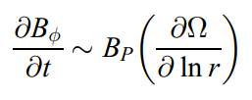
MHD asymmetry production
1 – Dipole – mirror symmetry – winded toroidal field is antisymmetric with respect to the equatorial plane
2 – Quadrupole – mirror symmetry – winded toroidal field is symmetric with respect to the equatorial plane
3 – dipole + quadrupole, offset dipole – no mirror symmetry – different values of poloidal magnetic field below and above the equator; toroidal field amplification by rotation proceeds differently in different hemispheres
4 – dipole + toroidal field – no mirror symmetry – winded azimuthal field is antisymmetric, while a symmetric toroidal field in the progenitor core is amplified during collapse due to flux freezing
MHD Rotational winding
(e.g. Ardeljan et al (2005), Burrows et al (2007)) is proportional to poloidal field + gradient of an angular velocity Ω (additionally poloidal field could amplify through matter fallback and MRI)

Slide 8
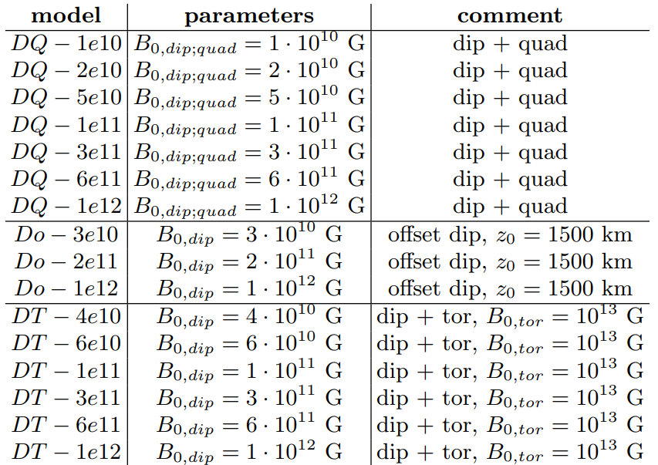

Simulated MRSN models of a rotating $35M_{⊙}$ star
16 models include three families of progenitor magnetic field configuration
DQ – equal strength dipole + quadrupole superposition (above equator “+”, below equator “–”)
Do – offset dipolar field (upstairs along the axis)
DT – dipolar field + strong symmetric toroidal component
Ref.: I.A. Kondratyev et al, Phys Rev D, 110 (8), 083025 (2024)

Slide 9
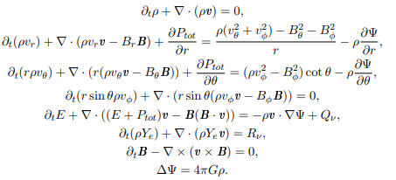

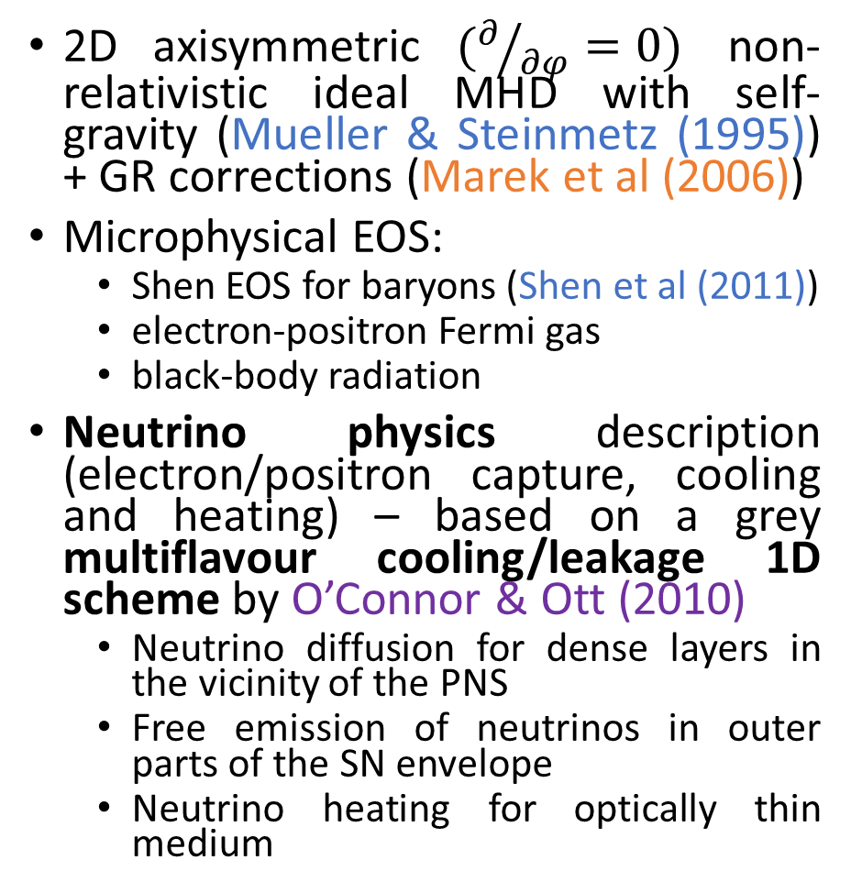
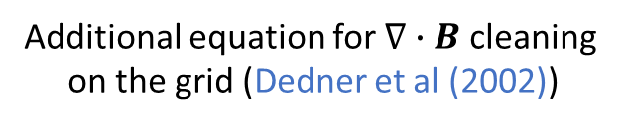
Physics input
2D axisymmetric $(∂/{∂φ}=0)$ non-relativistic ideal MHD with self-gravity (Mueller & Steinmetz (1995)) + GR corrections (Marek et al (2006))
Microphysical EOS:
  Shen EOS for baryons (Shen et al (2011))
  electron-positron Fermi gas
  black-body radiation
Neutrino physics description (electron/positron capture, cooling and heating) – based on a grey multiflavour cooling/leakage 1D scheme by O’Connor & Ott (2010)
  Neutrino diffusion for dense layers in the vicinity of the PNS
  Free emission of neutrinos in outer parts of the SN envelope
  Neutrino heating for optically thin medium
Numerical induction equation
Additional equation for $∇∙B$ cleaning
on the grid (Dedner et al (2002))

Slide 10
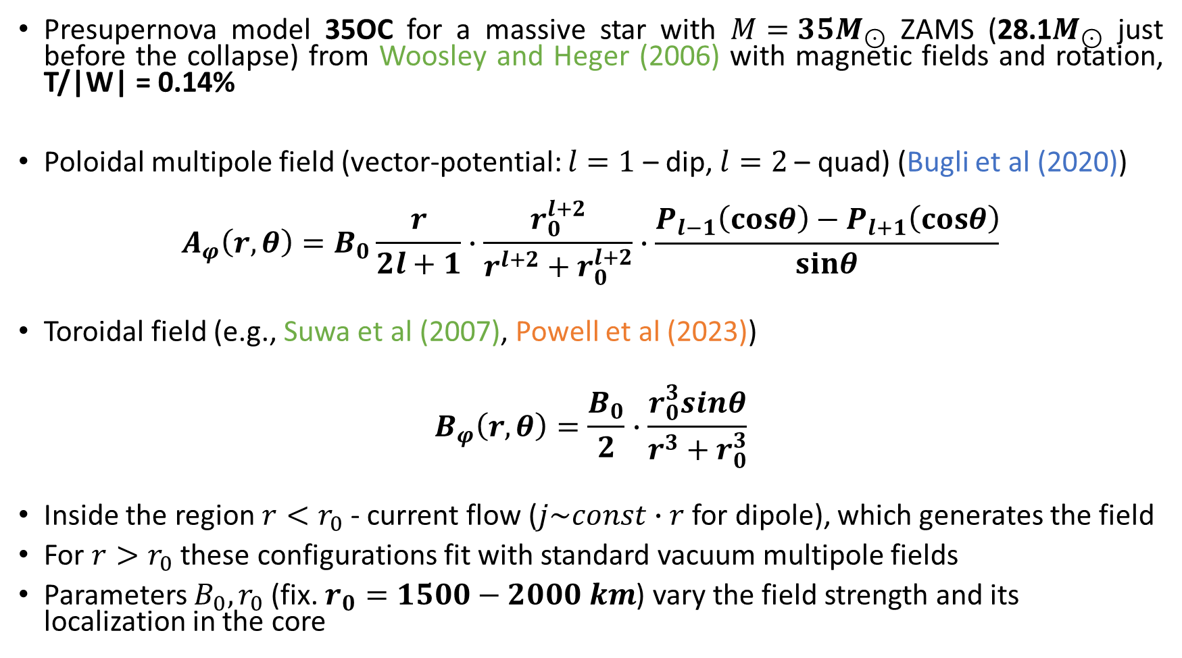
Initial conditions
Presupernova model 35OC for a massive star with $M=35M_{⊙}$ ZAMS (28.1$M_{⊙}$ just before the collapse) from Woosley and Heger (2006) with magnetic fields and rotation, T/|W| = 0.14%
Poloidal multipole field (vector-potential: $l=1$ – dip, $l=2$ – quad) (Bugli et al (2020))
$$A_{φ}\left(r,θ\right)=B_{0}\frac{r}{2l+1}∙\frac{r_{0}^{l+2}}{r^{l+2}+r_{0}^{l+2}}∙\frac{P_{l−1}\left(cosθ\right)−P_{l+1}\left(cosθ\right)}{sinθ}$$
Toroidal field (e.g., Suwa et al (2007), Powell et al (2023))
$$B_{φ}\left(r,θ\right)=\frac{B_{0}}{2}∙\frac{r_{0}^{3}sinθ}{r^{3}+r_{0}^{3}}$$
Inside the region $r<r_{0}$ - current flow ($j\sim const∙r$ for dipole), which generates the field
For $r>r_{0}$ these configurations fit with standard vacuum multipole fields
Parameters $B_{0}, r_{0}$ (fix. $r_{0}=1500−2000 km$) vary the field strength and its localization in the core

Slide 11
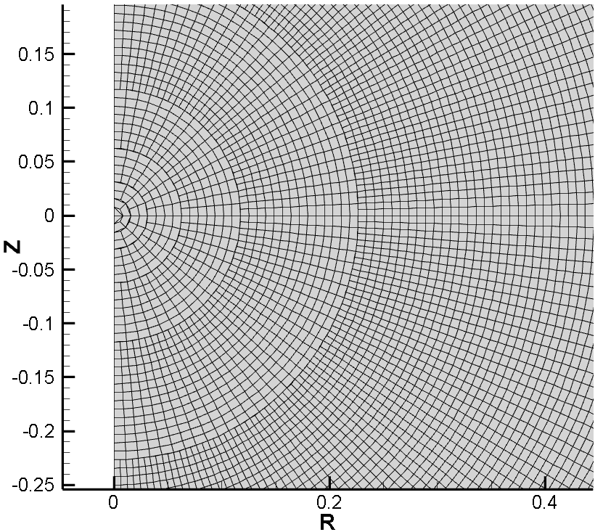
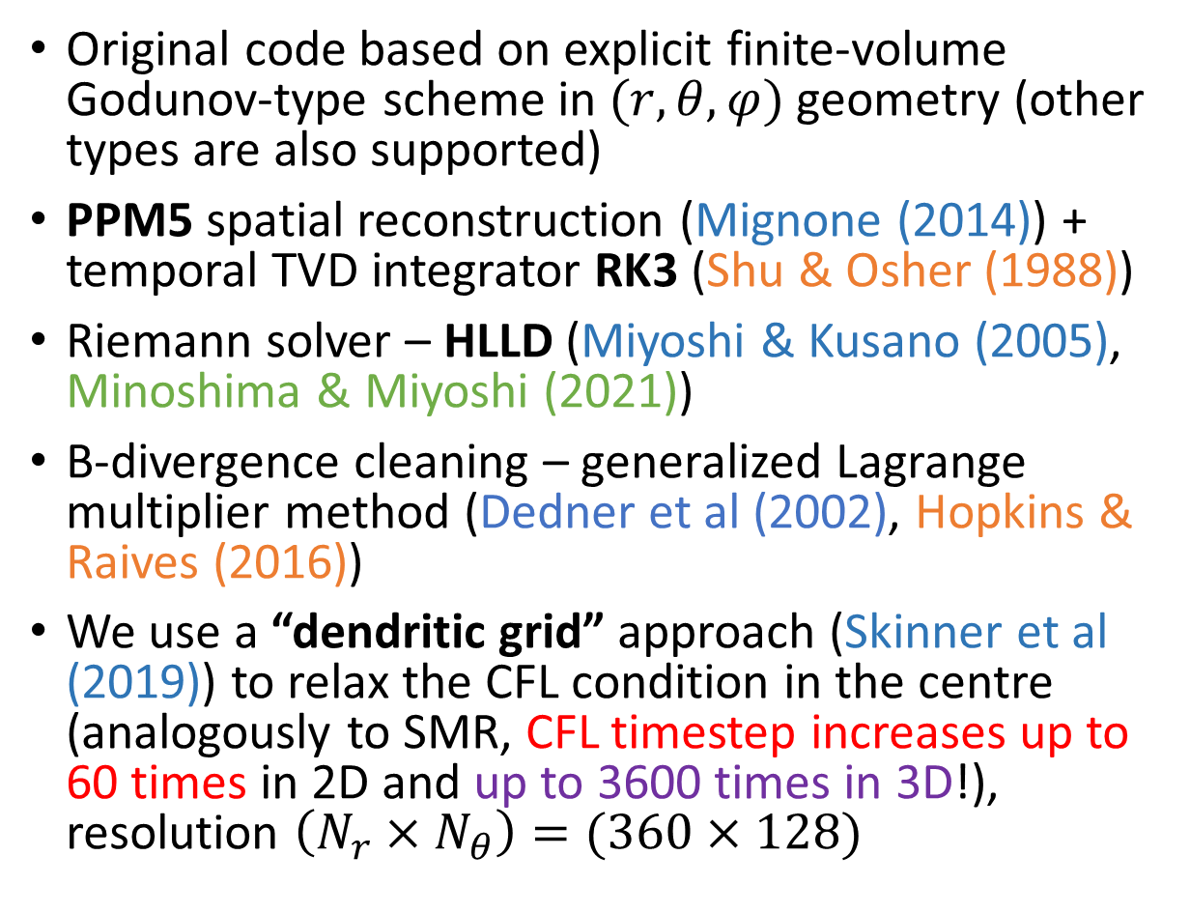
Numerical technique
Original code based on explicit finite-volume Godunov-type scheme in $(r,θ,φ)$ geometry (other types are also supported)
PPM5 spatial reconstruction (Mignone (2014)) + temporal TVD integrator RK3 (Shu & Osher (1988))
Riemann solver – HLLD (Miyoshi & Kusano (2005), Minoshima & Miyoshi (2021))
B-divergence cleaning – generalized Lagrange multiplier method (Dedner et al (2002), Hopkins & Raives (2016))
We use a “dendritic grid” approach (Skinner et al (2019)) to relax the CFL condition in the centre (analogously to SMR, CFL timestep increases up to 60 times in 2D and up to 3600 times in 3D!), resolution $\left(N_{r}×N_{θ}\right)=(360×128)$
Fig.: Example of the dendritic grid with uniform radial spacing

Slide 12
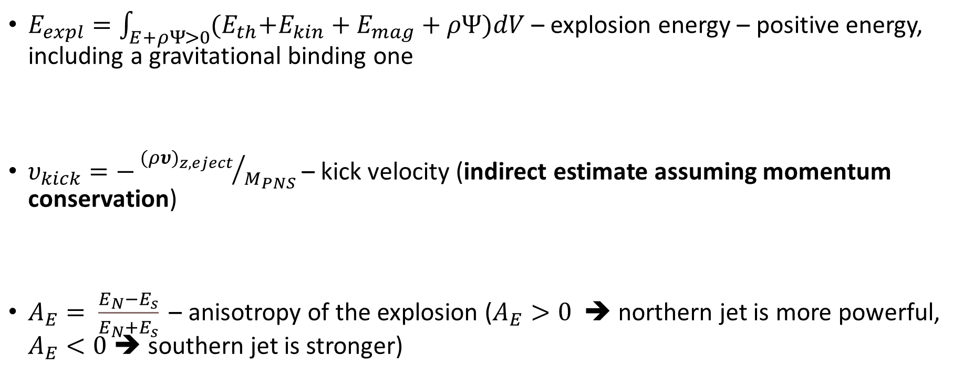
Diagnostic parameters for MR explosions and PNS kick velocity
$E_{expl}=\int_{E+ρΨ>0}{{(E}_{th}+E_{kin}+E_{mag}+ρΨ)dV}$ – explosion energy – positive energy, including a gravitational binding one
$υ_{kick}=−{{(ρυ)}_{z,eject}}/{M_{PNS}}$ – kick velocity (indirect estimate assuming momentum conservation)
$A_{E}= \frac{E_{N}−E_{s}}{E_{N}+E_{s}} \text{–}$ anisotropy of the explosion ($A_{E}>0$ ➔ northern jet is more powerful, $A_{E}<0$➔ southern jet is stronger)
Refs.: see, e.g.,
Buras et al (2006),
Powell et al (2023)

Slide 13
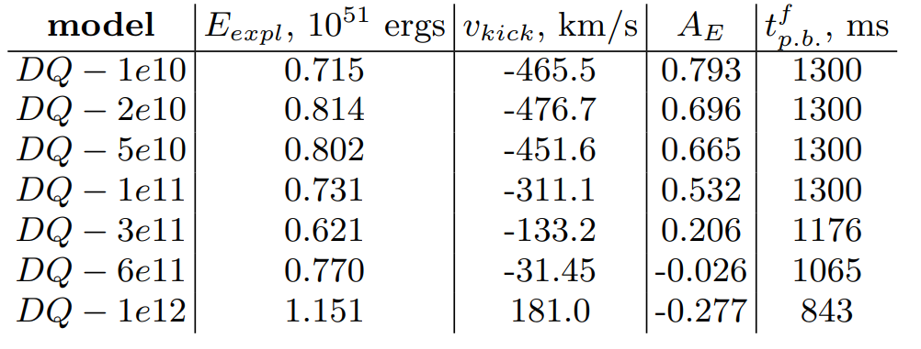
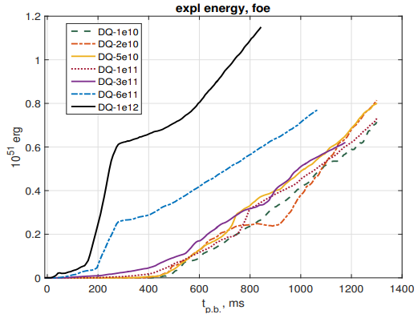
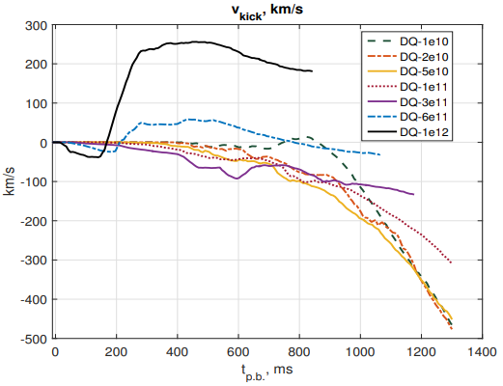
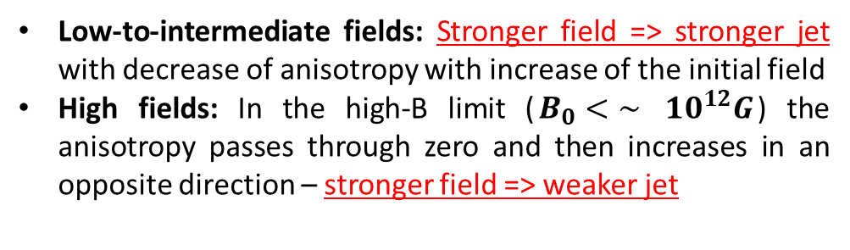
Results for DQ-models
Kondratyev et al., Phys Rev D, 110 (8) 083025 (2024)
Low-to-intermediate fields: Stronger field => stronger jet with decrease of anisotropy with increase of the initial field
High fields: In the high-B limit ($B_{0}<\sim$ ${10}^{12}G$) the anisotropy passes through zero and then increases in an opposite direction – stronger field => weaker jet

Slide 14
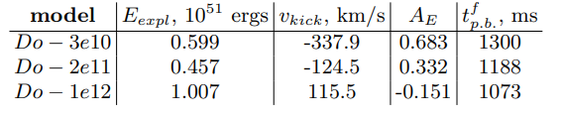
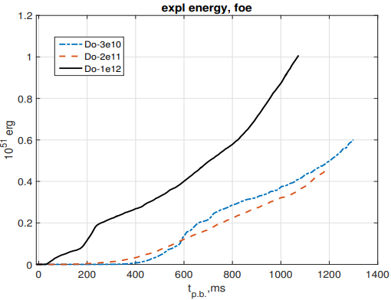
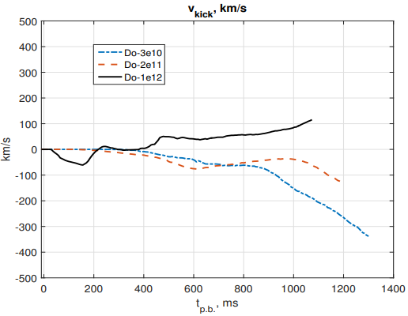
Results for Do-models
Results are similar qualitatively to DQ-models, since the offset field can be expanded into the superposition of centred multipoles
Same features on the plots, similar behaviour of the jet asymmetry and the PNS kick, but somehow smaller values of the PNS velocities, than in DQ-models

Slide 15
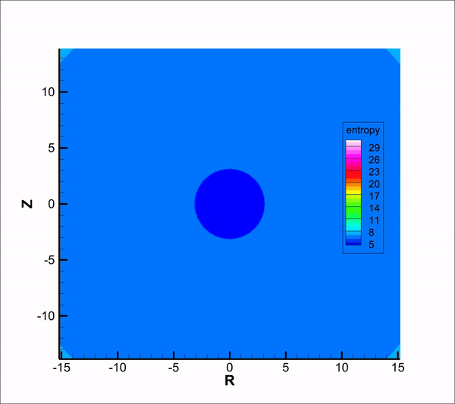
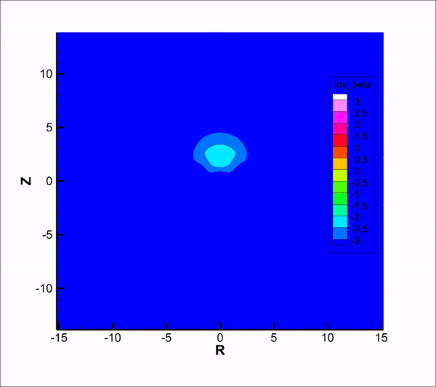
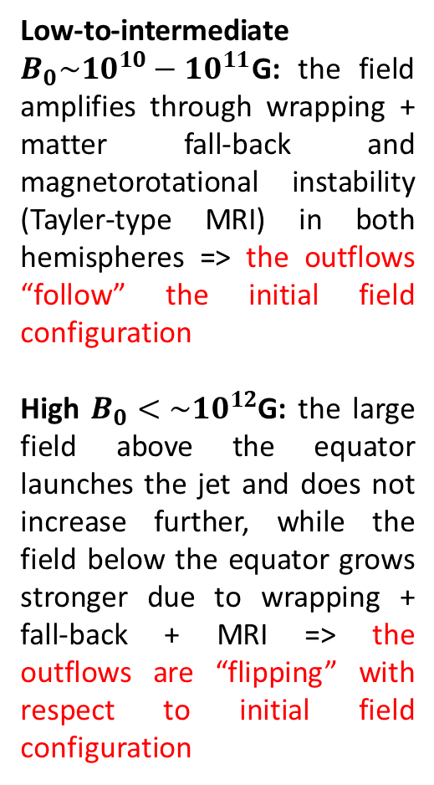
Results for DQ- and Do-models
Low-to-intermediate $B_{0}\sim {10}^{10}−{10}^{11}$G: the field amplifies through wrapping + matter fall-back and magnetorotational instability (Tayler-type MRI) in both hemispheres => the outflows “follow” the initial field configuration
High $B_{0}<\sim {10}^{12}$G: the large field above the equator launches the jet and does not increase further, while the field below the equator grows stronger due to wrapping + fall-back + MRI => the outflows are “flipping” with respect to initial field configuration
Evolution (0-1.6s) of
Specific entropy for Do-3e10
(low-to-intermediate-B case)
Evolution (0-1.3s) of
Inverse plasma beta for DQ-1e12
(high-B case)

Slide 16
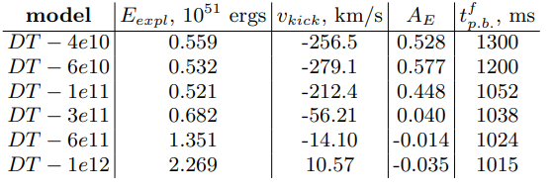
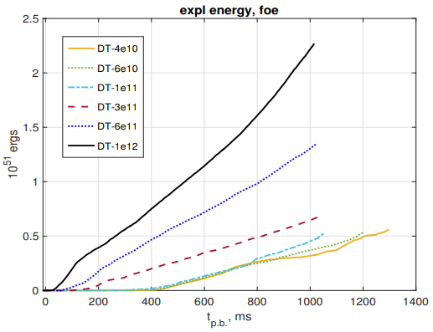
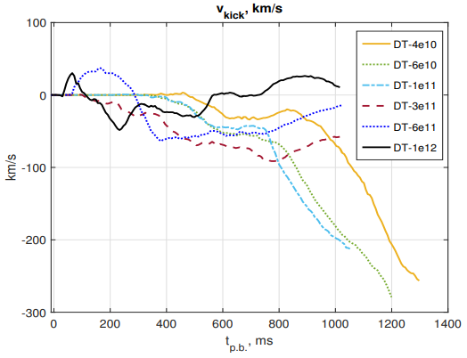
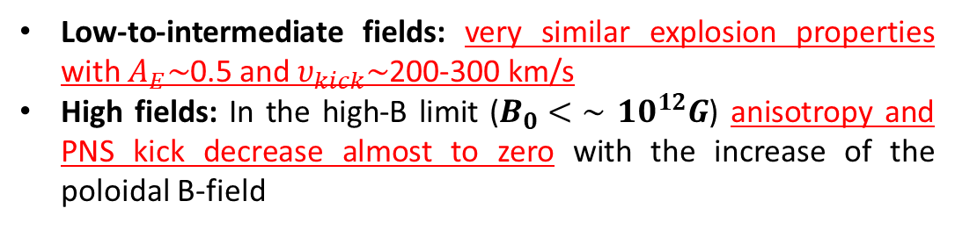
Results for DT-models
Low-to-intermediate fields: very similar explosion properties with $A_{E}\sim$0.5 and $υ_{kick}\sim$200-300 km/s
High fields: In the high-B limit ($B_{0}<\sim$ ${10}^{12}G$) anisotropy and PNS kick decrease almost to zero with the increase of the poloidal B-field

Slide 17
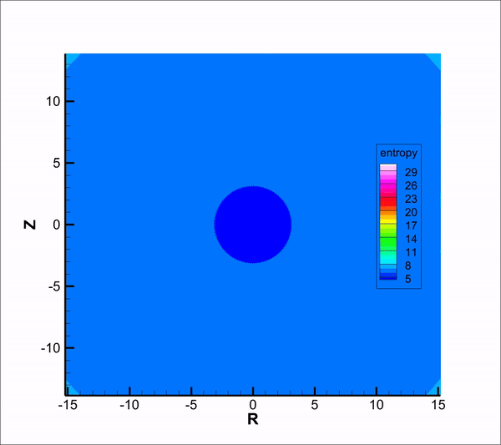
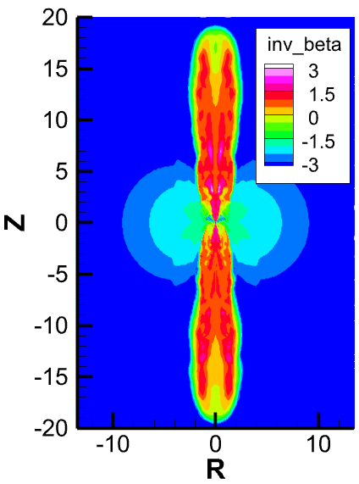
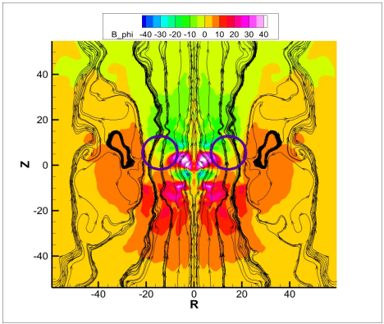
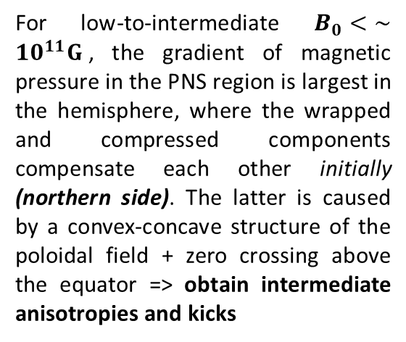
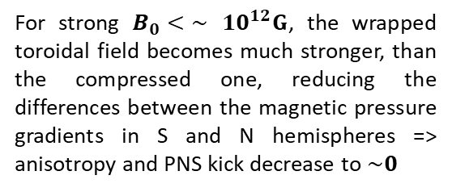
Results for DT-models
Toroidal field in PNS region at time = 256 ms p.b.
for DT-6e10
Inverse plasma beta at time = 440 ms after the core bounce, axis scale is in units of 1000 km
For low-to-intermediate $B_{0}<\sim$ ${10}^{11}G$, the gradient of magnetic pressure in the PNS region is largest in the hemisphere, where the wrapped and compressed components compensate each other initially (northern side). The latter is caused by a convex-concave structure of the poloidal field + zero crossing above the equator => obtain intermediate anisotropies and kicks
Evolution (0-1.5s) of
Specific entropy for DT-6e10
(low-to-intermediate-B case)
For strong $B_{0}<\sim$ ${10}^{12}G$, the wrapped toroidal field becomes much stronger, than the compressed one, reducing the differences between the magnetic pressure gradients in S and N hemispheres => anisotropy and PNS kick decrease to $\sim 0$
In all cases jets are formed almost simultaneously

Slide 18
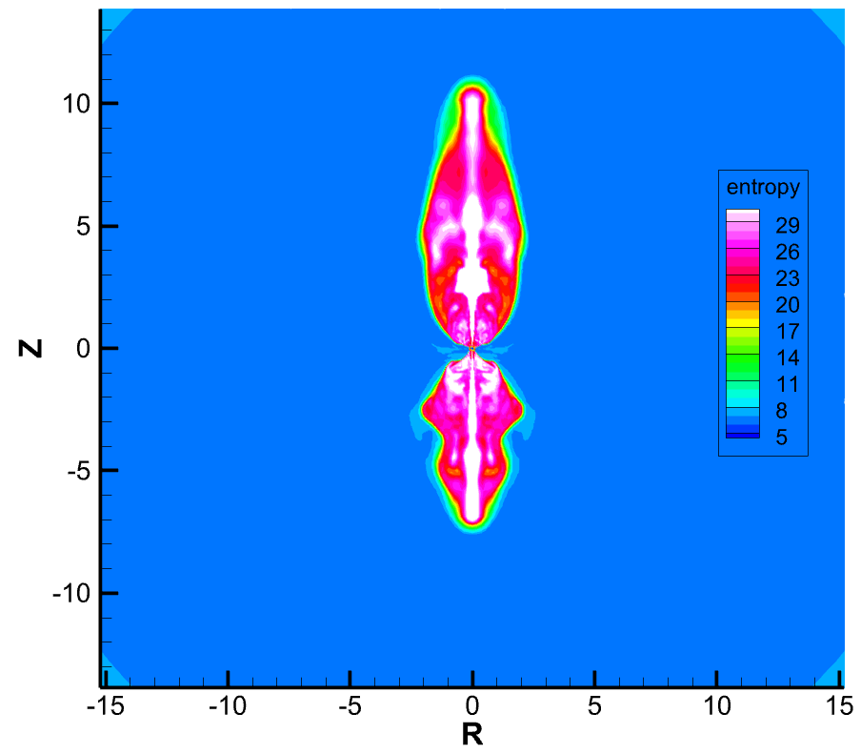
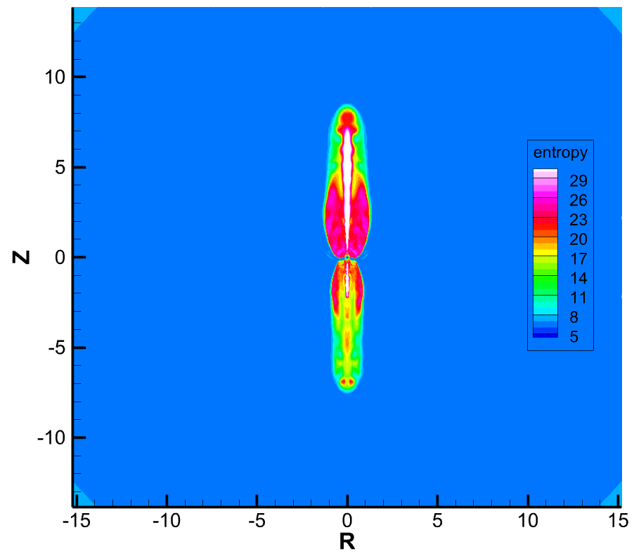
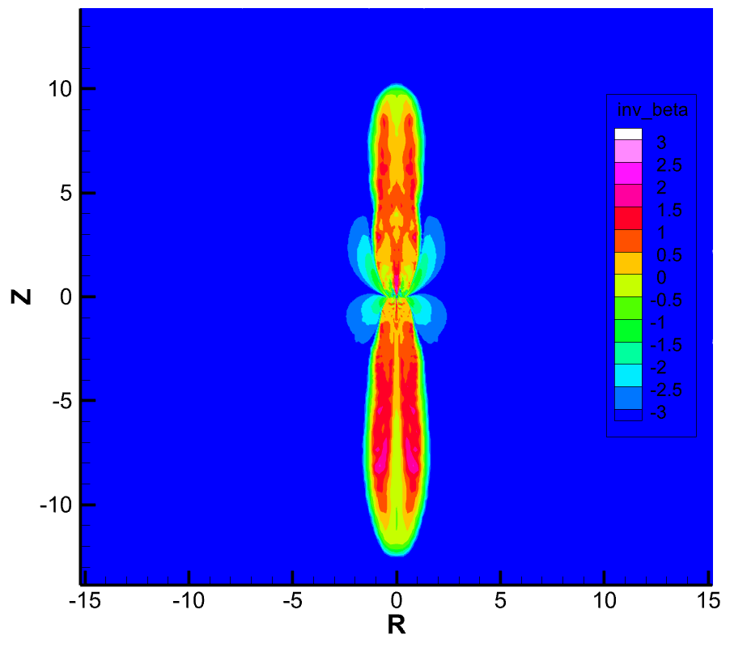
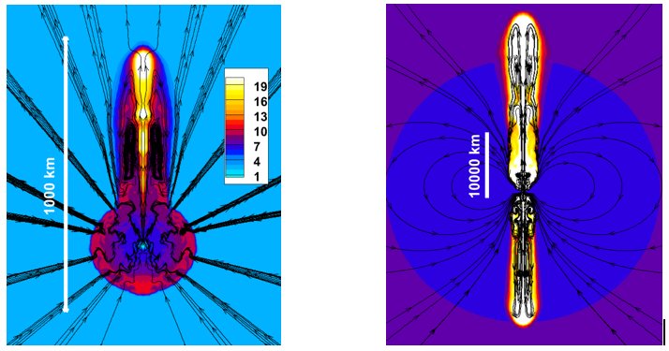
Illustrations of explosions (if animations do not work)
DQ-1e12 at time = 315 ms p.b.
DT-6e10 at time = 625 ms p.b.
DT-1e12 at time = 440 ms p.b.
Do-3e10 at time = 807 ms p.b.
DQ-3e11 in dynamics at time = 84 ms pb (left, first jet is formed) and 894 ms pb (right, second jet is formed)

Slide 19
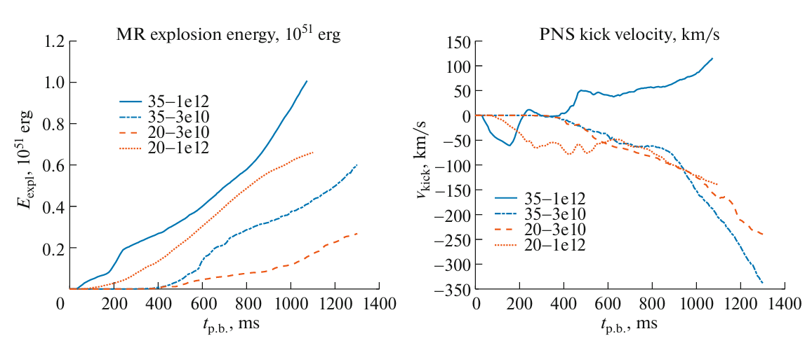
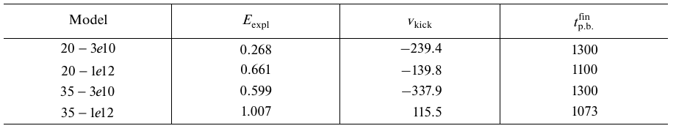
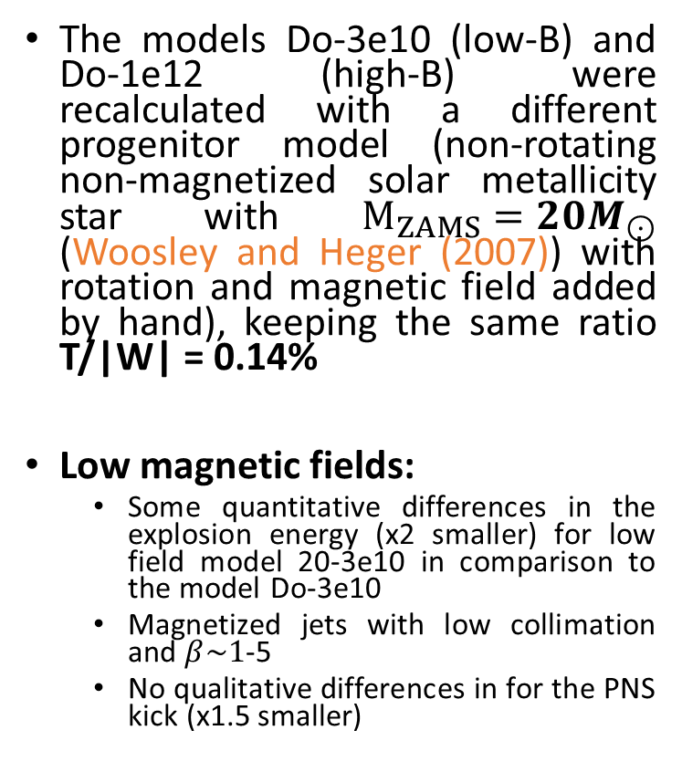
Dependence on the progenitor mass
Kondratyev et al., Fluid Dynamics (2025)
The models Do-3e10 (low-B) and Do-1e12 (high-B) were recalculated with a different progenitor model (non-rotating non-magnetized solar metallicity star with $M_{ZAMS}=20M_{⊙}$ (Woosley and Heger (2007)) with rotation and magnetic field added by hand), keeping the same ratio T/|W| = 0.14%
Low magnetic fields:
  Some quantitative differences in the explosion energy (x2 smaller) for low field model 20-3e10 in comparison to the model Do-3e10
  Magnetized jets with low collimation and $β\sim 1$-5
  No qualitative differences in for the PNS kick (x1.5 smaller)

Slide 20
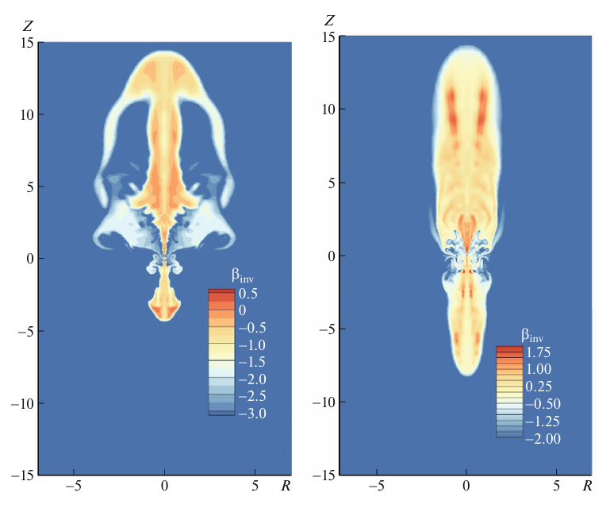
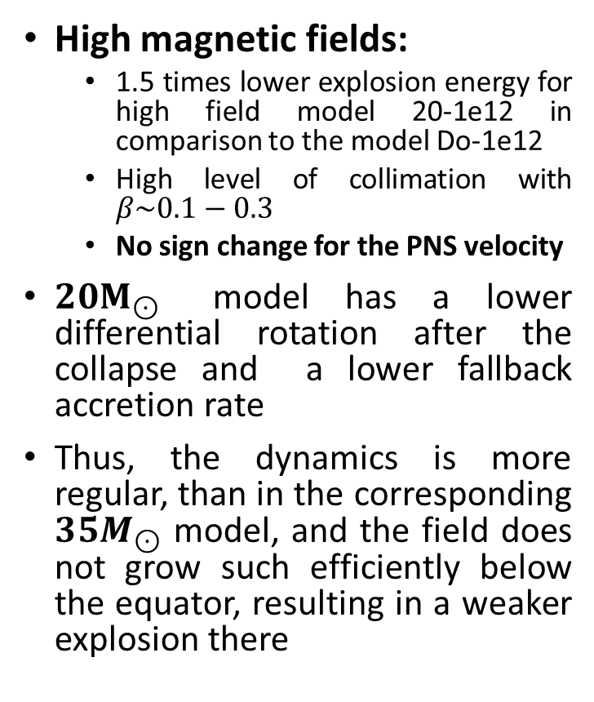
Dependence on the progenitor mass
High magnetic fields:
  1.5 times lower explosion energy for high field model 20-1e12 in comparison to the model Do-1e12
  High level of collimation with $β\sim 0.1−0.3$
  No sign change for the PNS velocity
$20M_{⊙}$ model has a lower differential rotation after the collapse and a lower fallback accretion rate
Thus, the dynamics is more regular, than in the corresponding $35M_{⊙}$ model, and the field does not grow such efficiently below the equator, resulting in a weaker explosion there
20-3e10, 1011 ms p.b.
20-1e12, 415 ms p.b.

Slide 21
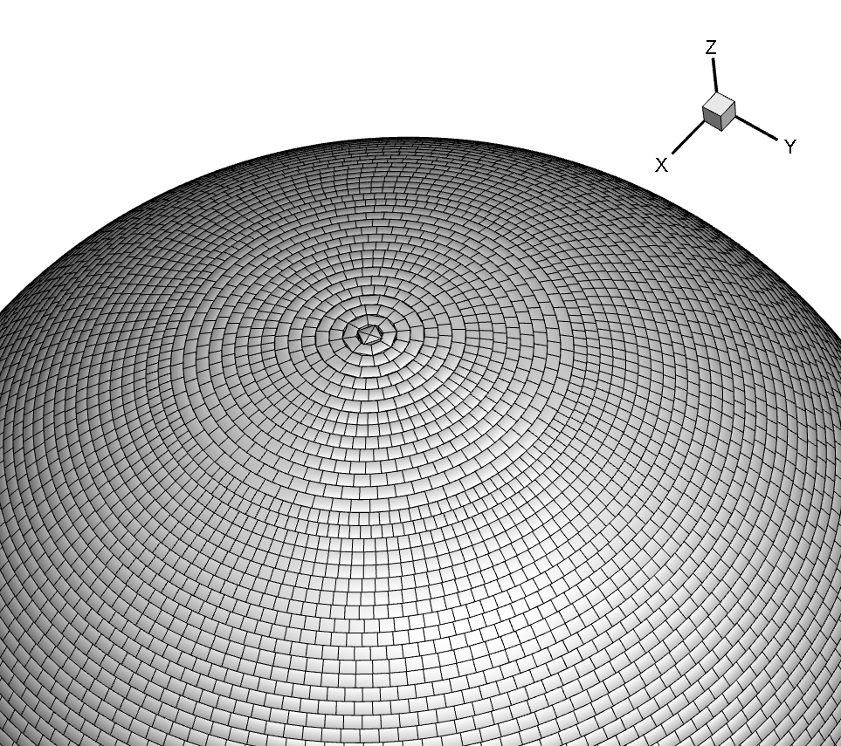
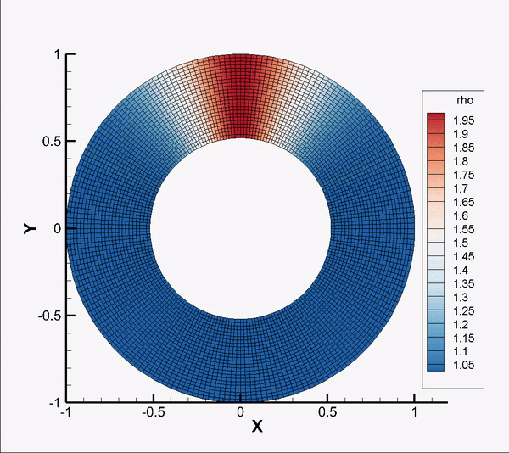
Further work on the way to 3D MRSN models
Developed features in 3D MHD code:
PLM, PPM (Mignone, JCP (2014)) and MP5 (Suresh & Huynh (1997)) spatial reconstructions + TVD Runge-Kutta methods in time (Shu & Osher (1988))
HLL-family methods for fluxes calculation (Harten, Lax & Van Leer, SIAM Review (1983); Miyoshi & Kusano, JCP (2005))
“Dendritic grid” usage (Skinner et al, ApJ Suppl (2019)) to avoid stringent CFL condition near the axis (SMR-like derefinement, ~x1000 speed-up)
Quasi-Lagrangian method with moving grid for differential rotation, as in “DISCO” code (Duffel, ApJ Suppl (2016))
MHD-scheme utilizes GLM-type divergence cleaning (Dedner et al, JCP (2002)) in its Galilean-invariant form (“GIZMO” code by Hopkins & Raives, MNRAS (2016))
Hybrid Coarray Fortran/OpenMP parallelization (for 3D simulations and 2D MRI-resolving models)
Fig.: example of computational grid

Slide 22
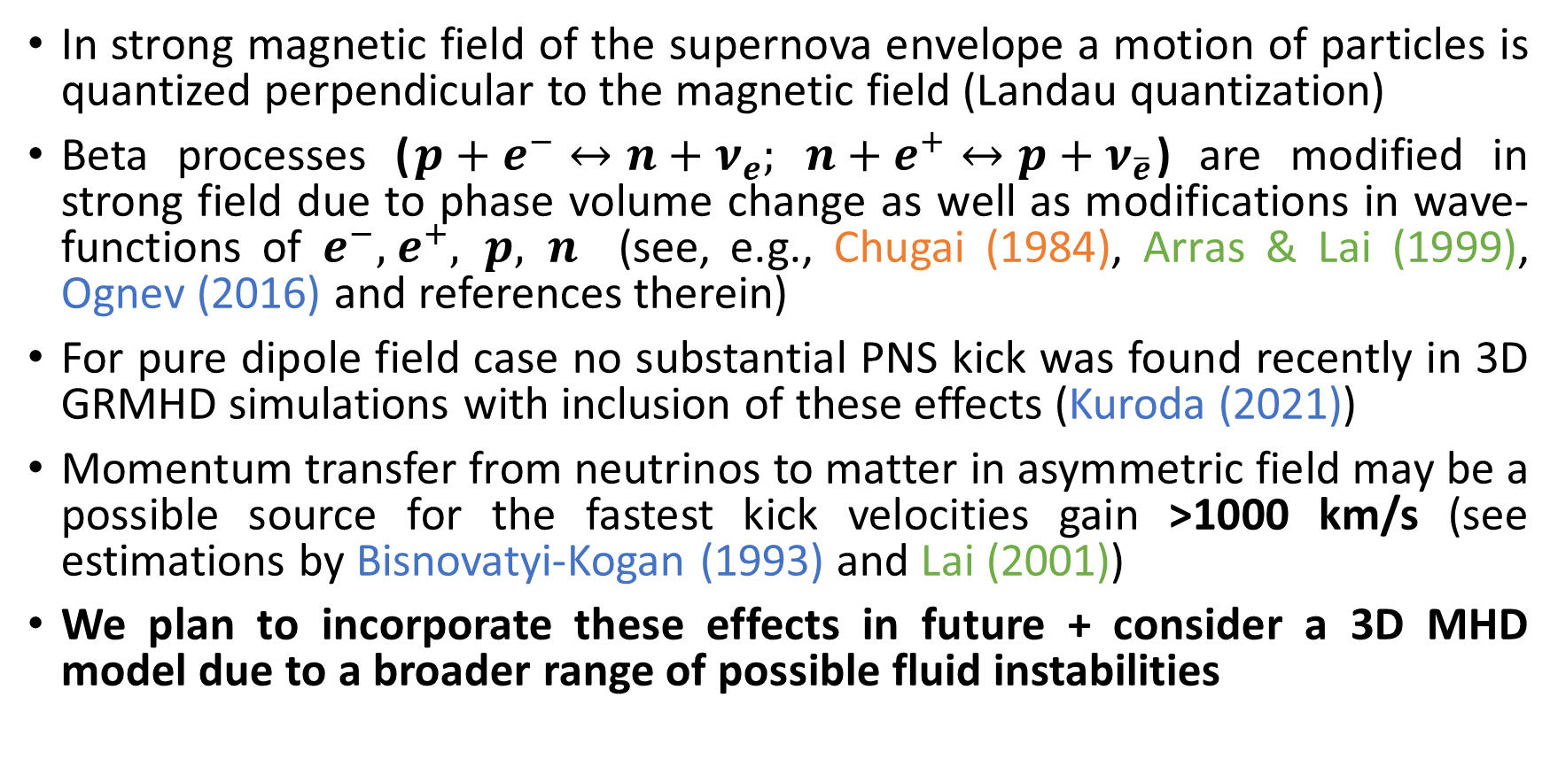
Further work on neutrino supported NS kick
In strong magnetic field of the supernova envelope a motion of particles is quantized perpendicular to the magnetic field (Landau quantization)
Beta processes ($p+e^{−}↔n+ν_{e}; n+e^{+}↔p+ν_{\overline{e}}$) are modified in strong field due to phase volume change as well as modifications in wave-functions of $e^{−},{ e}^{+}, p, n$ (see, e.g., Chugai (1984), Arras & Lai (1999), Ognev (2016) and references therein)
For pure dipole field case no substantial PNS kick was found recently in 3D GRMHD simulations with inclusion of these effects (Kuroda (2021))
Momentum transfer from neutrinos to matter in asymmetric field may be a possible source for the fastest kick velocities gain >1000 km/s (see estimations by Bisnovatyi-Kogan (1993) and Lai (2001))
We plan to incorporate these effects in future + consider a 3D MHD model due to a broader range of possible fluid instabilities

Slide 23
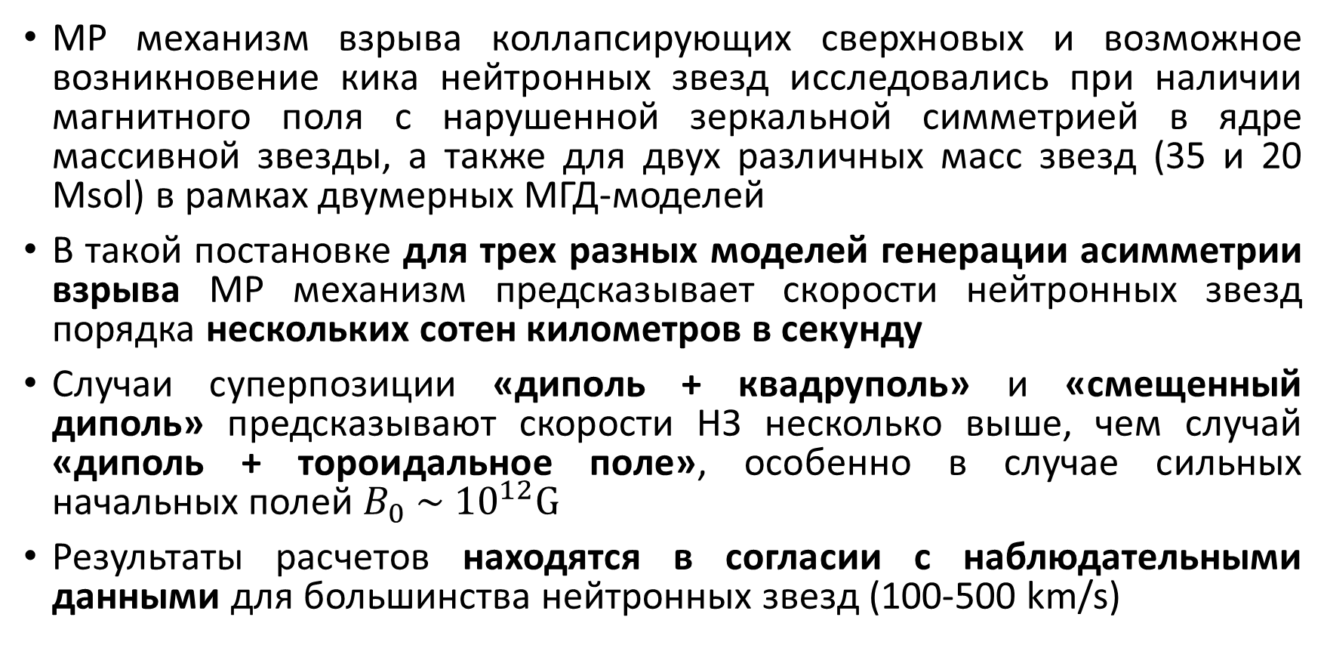
Заключение
МР механизм взрыва коллапсирующих сверхновых и возможное возникновение кика нейтронных звезд исследовались при наличии магнитного поля с нарушенной зеркальной симметрией в ядре массивной звезды, а также для двух различных масс звезд (35 и 20 Msol) в рамках двумерных МГД-моделей
В такой постановке для трех разных моделей генерации асимметрии взрыва МР механизм предсказывает скорости нейтронных звезд порядка нескольких сотен километров в секунду
Случаи суперпозиции «диполь + квадруполь» и «смещенный диполь» предсказывают скорости НЗ несколько выше, чем случай «диполь + тороидальное поле», особенно в случае сильных начальных полей $B_{0} \sim$ ${10}^{12}G$
Результаты расчетов находятся в согласии с наблюдательными данными для большинства нейтронных звезд (100-500 km/s)
Спасибо за внимание! ☺

Slide 24
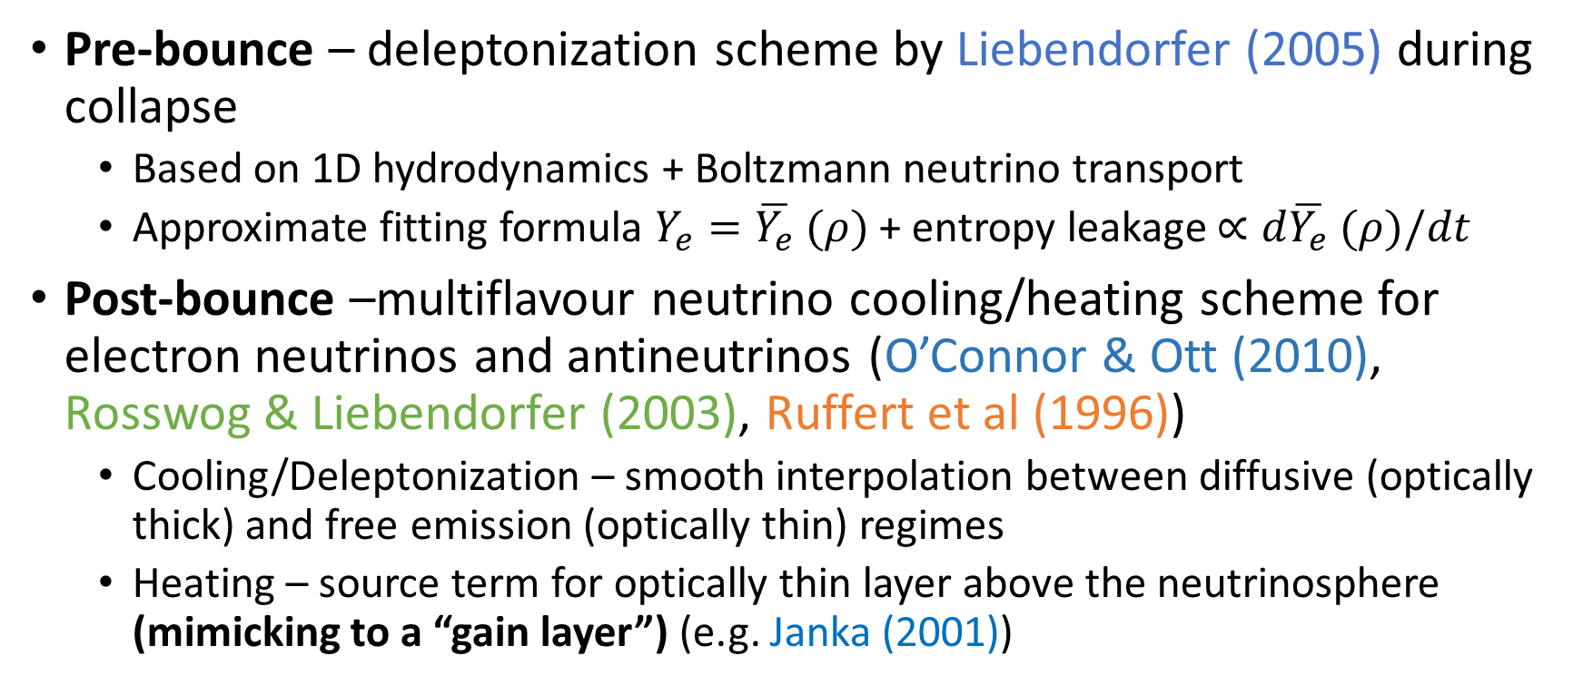
Add.: Neutrino physics – leakage scheme
Pre-bounce – deleptonization scheme by Liebendorfer (2005) during collapse
  Based on 1D hydrodynamics + Boltzmann neutrino transport
  Approximate fitting formula $Y_{e}=\overline{Y_{e}} (ρ)$ + entropy leakage $∝d\overline{Y_{e}} (ρ)/dt$
Post-bounce –multiflavour neutrino cooling/heating scheme for electron neutrinos and antineutrinos (O’Connor & Ott (2010), Rosswog & Liebendorfer (2003), Ruffert et al (1996))
  Cooling/Deleptonization – smooth interpolation between diffusive (optically thick) and free emission (optically thin) regimes
  Heating – source term for optically thin layer above the neutrinosphere (mimicking to a “gain layer”) (e.g. Janka (2001))

Slide 25
Add.: Microprocesses with electron (anti-) neutrinos (O’Connor & Ott (2010))
Free emission (optically thin medium) –
  Beta-captures of electrons (neutrino) and positrons (anti-neutrino) by nucleons (Rosswog & Liebendorfer (2003))
  “thermal” processes – pair annihilation, plasmon decay, photoproduction (Schindler et al (1987))
Neutrino diffusion (opacity sources, optically thick medium) –
  Absorption on nucleons
  Elastic scattering on nucleons and nuclei
Neutrino heating above the neutrinosphere (optically thin medium) –
  Absorption of neutrino by neutron
  Absorption of antineutrino by proton

Slide 26
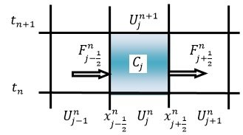

Add.: Numerical technique – методы Годуновского типа
Разработаны для решения уравнений сжимаемых сплошных сред в форме законов сохранения (С.К. Годунов, Мат.Сборник (1959))
Уравнения рассматриваются в терминах эволюции интегральных величин (массы, импульса, энергии и т.д.) внутри расчетных ячеек (конечных объемов)
Между ячейками возникают состояния, которые можно трактовать как произвольные разрывы => для вычисления потоков величин между ячейками решается задача Римана
Возможны модификации на более высокие порядки при использовании кусочно-полиномиальных расширений (оригинальный метод Годунова работает с кусочно-постоянными профилями и имеет первый порядок точности)
Очень популярны в астрофизике

Slide 27



Add.: MHD-test 1 – magnetized blast wave
Blast wave in magnetized medium, time = 0.2 (comparison to 3D ATHENA code), mesh $\left(r,θ\right)$=128x256 (density)

Slide 28



Add.: MHD-test 2 – Orszag-Tang vortex problem
Orszag-Tang vortex problem, time = 0.5 (comparison to FLASH code), mesh $(x,y)$=256x256 (density)
https://flash.rochester.edu/site/flashcode/
user_support/flash_ug_devel/node188.html (512x512)

